Slide 1
5TH IHAP AWARDS 2020
Virtual
Awarding Ceremonies
December 15, 2020
2:00 PM

Slide 3
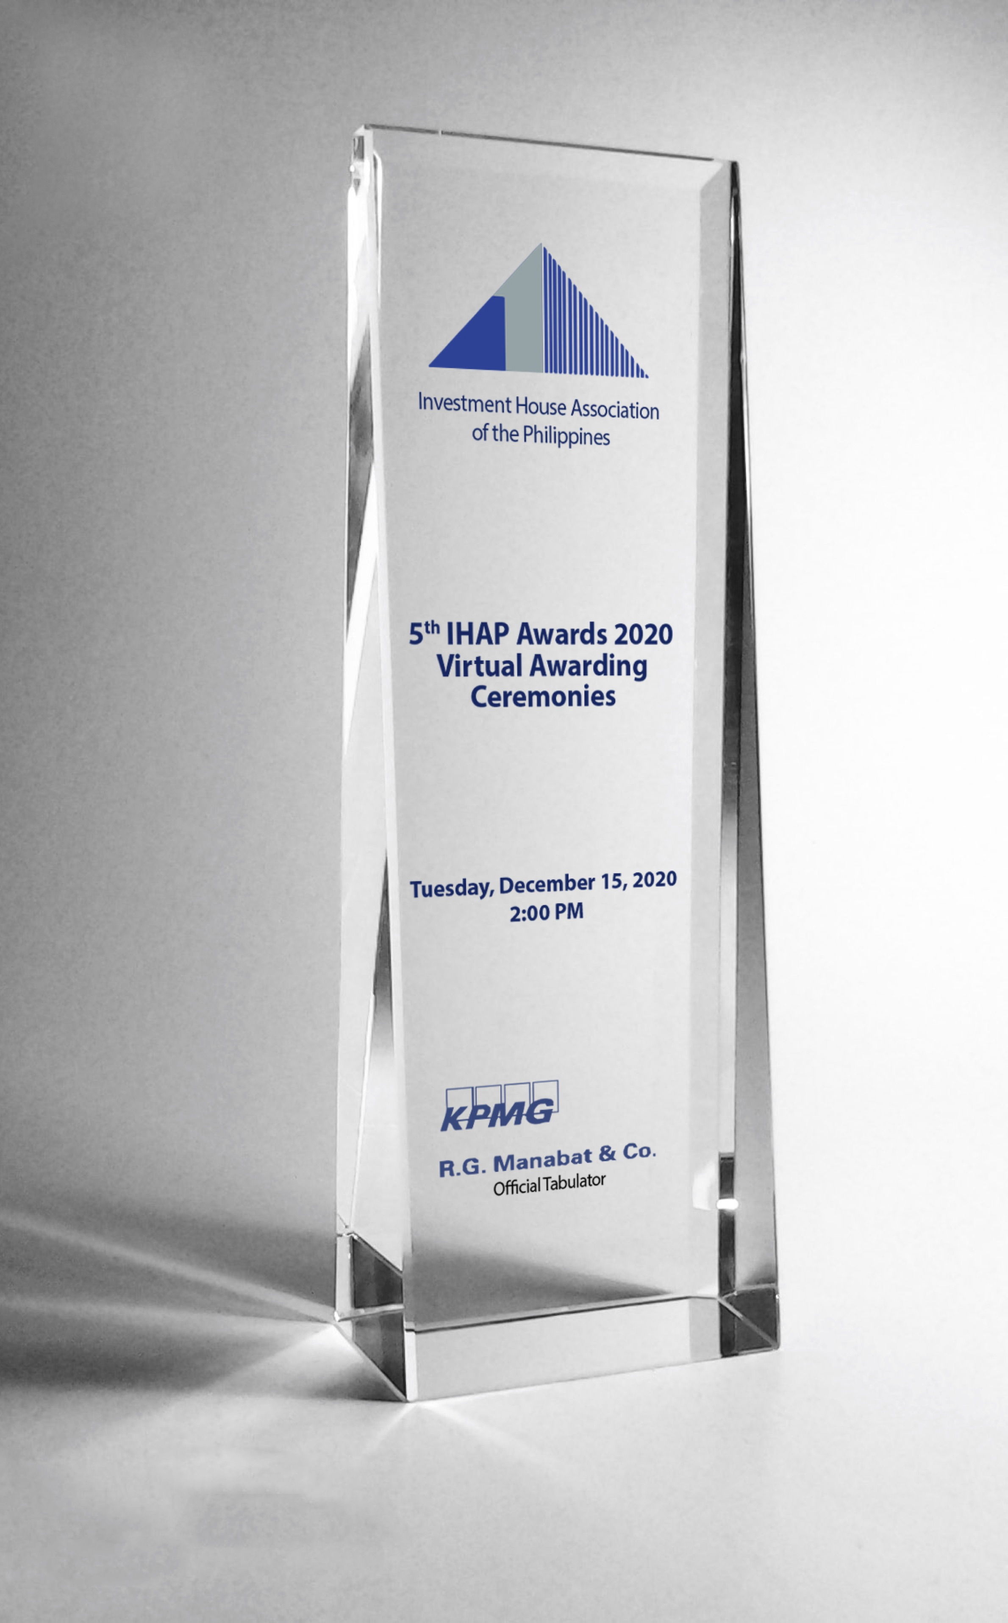
Notes:
Good afternoon Ladies and Gentlemen and fellow IHAP partners, colleagues and friends.
GOOD AFTERNOON and WELCOME to the 1st VIRTUAL AWARDING CEREMONIES for the 5th IHAP AWARDS 2020.
I am Claudine del Rosario of RCBC Capital Corporation and I will be your HOST for this afternoon’s event.
The IHAP Awards is an alliance forged by the Investment House Association of the Philippines (IHAP) and KPMG R.G. Manabat & Co. to form a mutually beneficial relationship, to provide for collaboration in marketing and promotion of their respective services and most specifically for the development and enhancement of the capital markets in the Philippines.
The IHAP Awards is on it’s 5th edition this year and still going strong despite the pandemic that has sidelined most activities these past 9 months. Like all other events and activities, everything has to be virtual so as to avoid face-to-face contact and large gatherings. So for this year’s event we’re holding it virtually via Zoom and I am gladdened to see that so many of you have taken the time to be here. Yes, the Awarding Ceremonies is virtual BUT rest assured the award trophies are REAL and we will deliver them to the winners’ offices after the holidays.
So let’s get on with the show….

Slide 4
WELCOME REMARKS
MR. ROBERT M. LEHMANN – IHAP PRESIDENT
President and CEO
Amalgamated Investment Bancorporation

Slide 5
WORDS FROM OFFICIAL TABULATOR
MR. MICHAEL ARCATOMY H. GUARIN
Partner and Head – Deal Advisory
KPMG RG Manabat & Co.

Slide 6
PANEL OF JUDGES

Slide 7
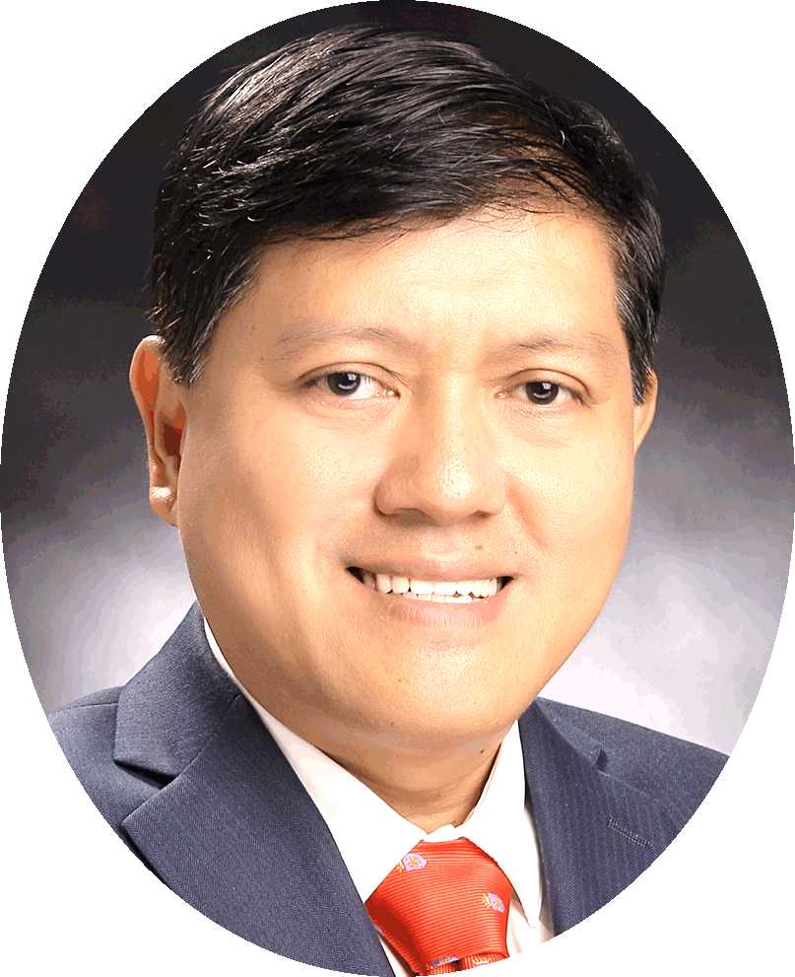
Atty. Emilio B. Aquino
Chairman
Securities and Exchange Commission

Slide 8
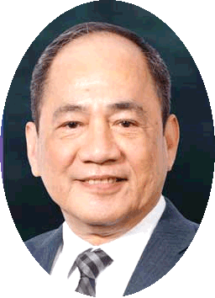
Mr. Ramon S. Monzon
President and CEO
Philippine Stock Exchange, Inc.

Slide 9
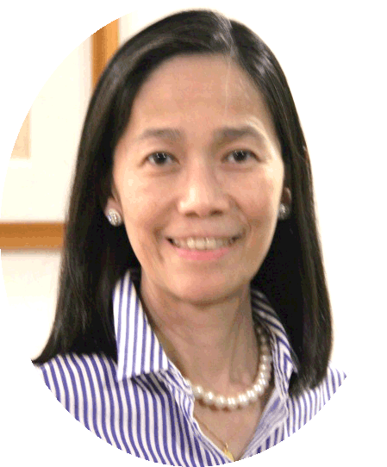
Ms. Ma. Theresa B. Ravalo
President
Philippine Dealing System Holdings Corp.

Slide 10
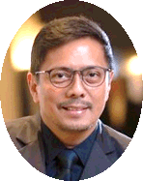
Mr. Noel S. Reyes
President
Fund Managers Association of the Philippines

Slide 11
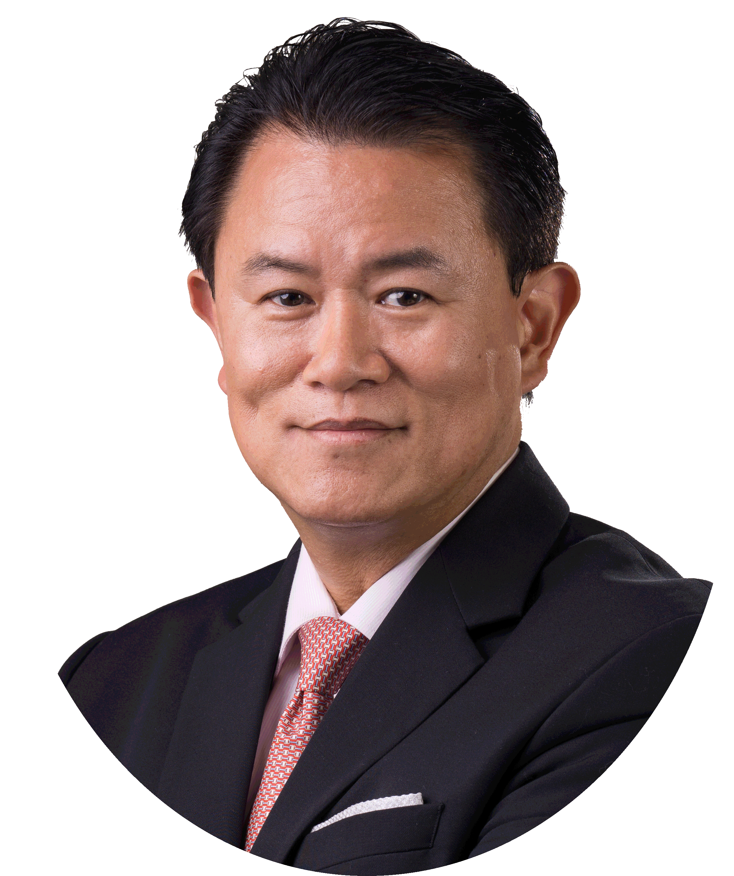
Mr. Jose Jerome R. Pascual, III
President
Financial Executives of the Philippines

Slide 12
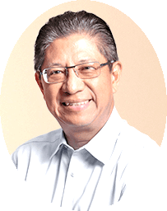
Mr. Jaime E. Ysmael
President
Shareholders’ Association of the Philippines

Slide 13
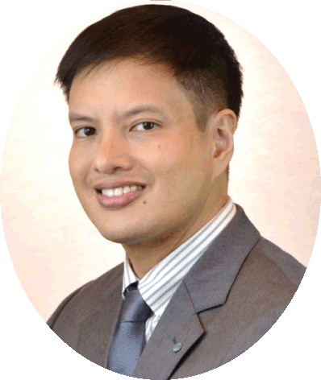
Mr. Robert B. Ramos
President
CFA Society of the Philippines
Notes:
There you have the 7 distinguished Judges who have graciously participated in this event of IHAP which aims to promote a better understanding of roles and functions of investment houses and to enhance their contribution to the growth of Philippine business and the economy particularly through the development of the capital market.
We’re now in the highpoint of this virtual event – finally we’re at the Awards Proper with the proclamation of winners. As mentioned earlier this is a virtual awarding ceremony but that is the only thing virtual here. The trophies that will be shown here are actual replicas of the trophies that the winners will be receiving. The trophies will be delivered to the winners’ offices after the holidays.
The IHAP Awards competition has 5 deal categories namely: Best Advisory Deal, Best Equity Deal, Best Fixed Income Deal, Best Project Finance Deal and Deal of the Year .
There are 5 house categories namely: Best Advisory House, Best Equity House, Best Fixed Income House, Best Project Finance House and Investment House of the Year.
Beginning last year, at the 4th IHAP Awards 2019, small to midcap deals up to PhP 2Bn have been open to contention for deal awards namely: Best Advisory Deal, Best Equity Deal, Best Fixed Income Deal and Best Project Finance Deal.
Without further ado, let’s get on with the ceremonies. Let’s start with the awards for the Small to Midcap Deals. May I call on Mr. Dindo Caguiat, IHAP Director and Managing Director of ICCP to announce the winner for BEST ADVISORY DEAL – Small – Midcap issues.

Slide 14
5TH IHAP AWARDS 2020
4780 Ortigas Avenue Extension, Pasig City, Metro Manila
Notes:
There you have the 7 distinguished Judges who have graciously participated in this event of IHAP which aims to promote a better understanding of roles and functions of investment houses and to enhance their contribution to the growth of Philippine business and the economy particularly through the development of the capital market.
We’re now in the highpoint of this virtual event – finally we’re at the Awards Proper with the proclamation of winners. As mentioned earlier, this is a virtual awarding ceremony but that is the only thing virtual here. The trophies that will be shown here are actual replicas of the trophies that the winners will be receiving. The trophies will be delivered to the winners’ offices after the holidays.
The IHAP Awards competition has 5 deal categories namely: Best Advisory Deal, Best Equity Deal, Best Fixed Income Deal, Best Project Finance Deal and Deal of the Year .
There are 5 house categories namely: Best Advisory House, Best Equity House, Best Fixed Income House, Best Project Finance House and Investment House of the Year.
Beginning last year, at the 4th IHAP Awards 2019, small to midcap deals up to PhP 2Bn have been open for contention for deal awards namely: Best Advisory Deal, Best Equity Deal, Best Fixed Income Deal and Best Project Finance Deal.
Without further ado, let’s get on with the ceremonies. Let’s start with the awards for the Small to Midcap Deals. May I call on Mr. Dindo Caguiat, IHAP Director and Managing Director of ICCP to announce the winner for BEST ADVISORY DEAL – Small – Midcap issues.

Slide 15
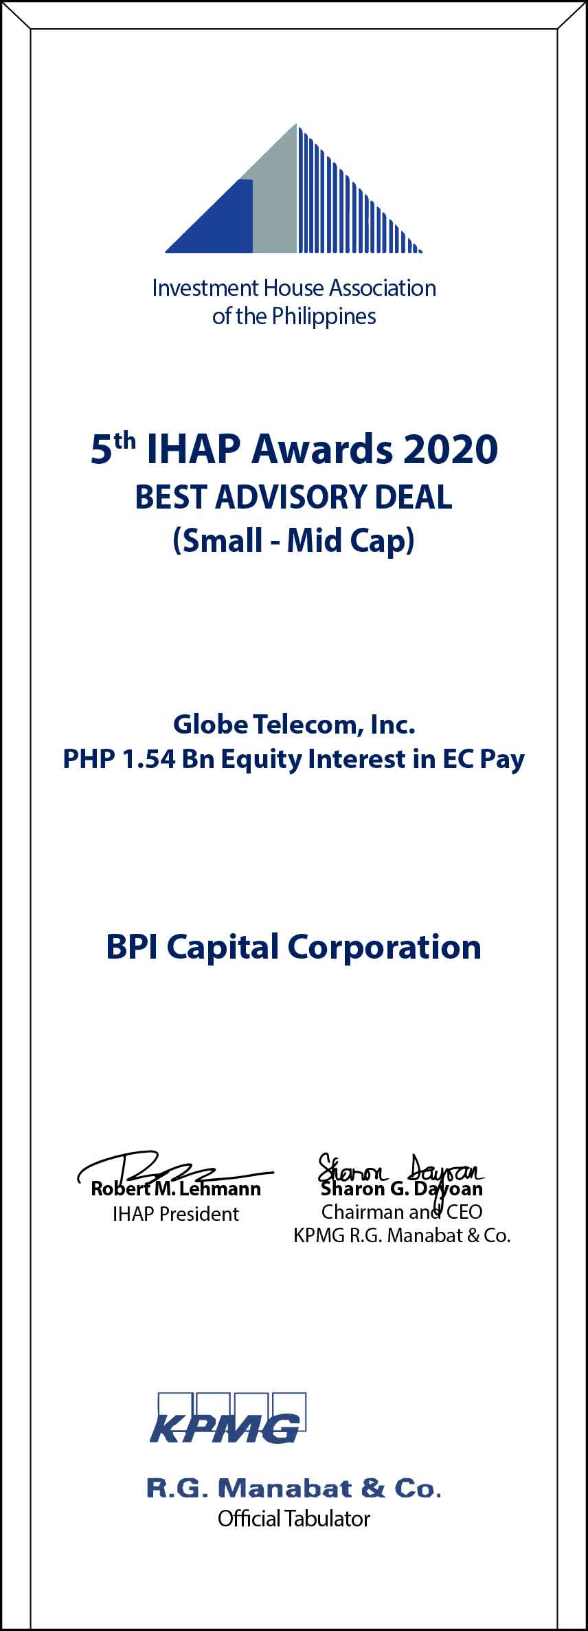
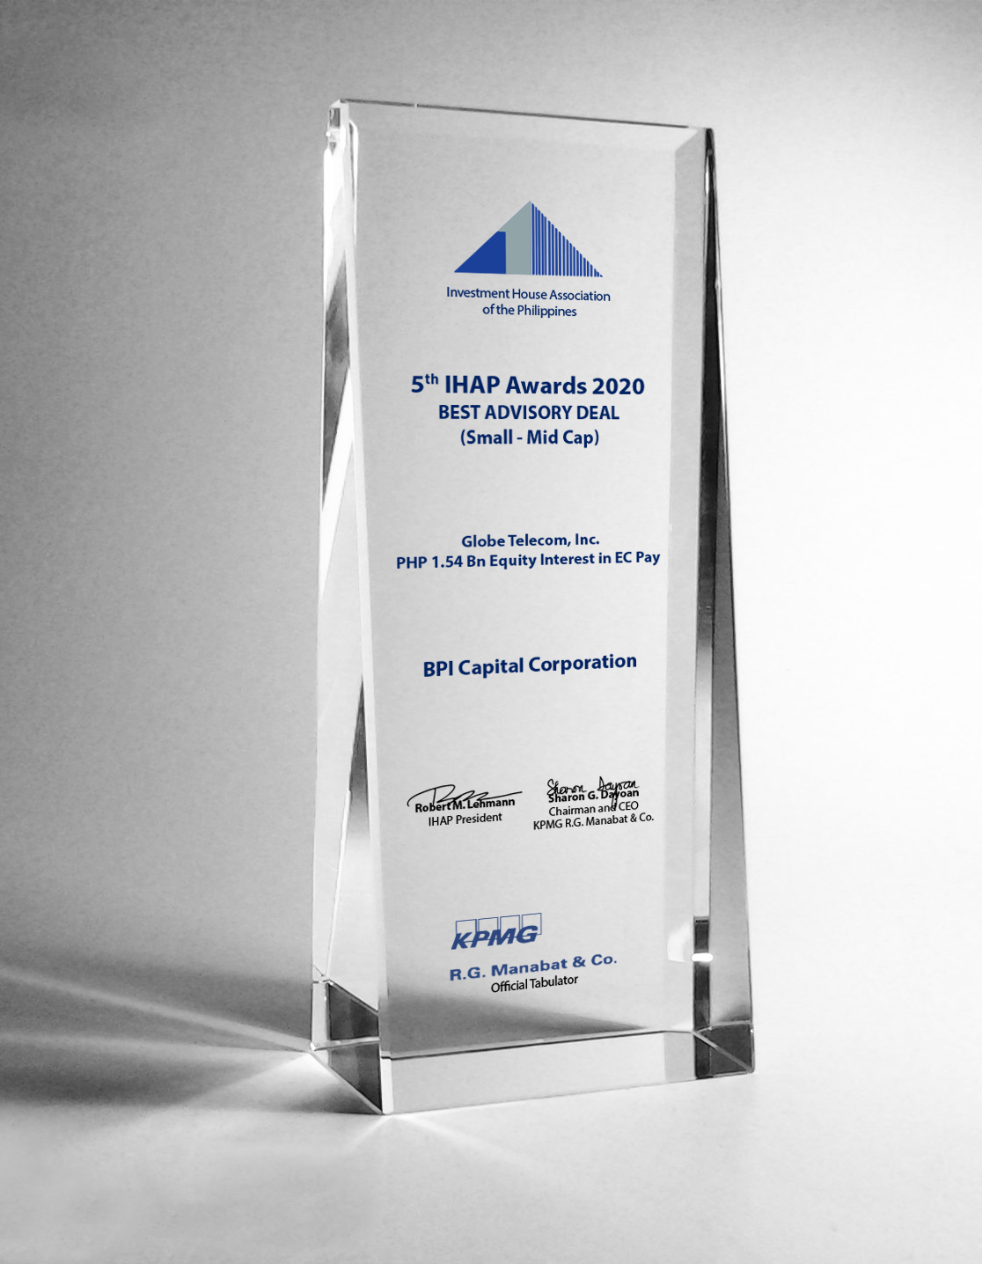
BEST ADVISORY DEAL Small – Mid Cap

Slide 16
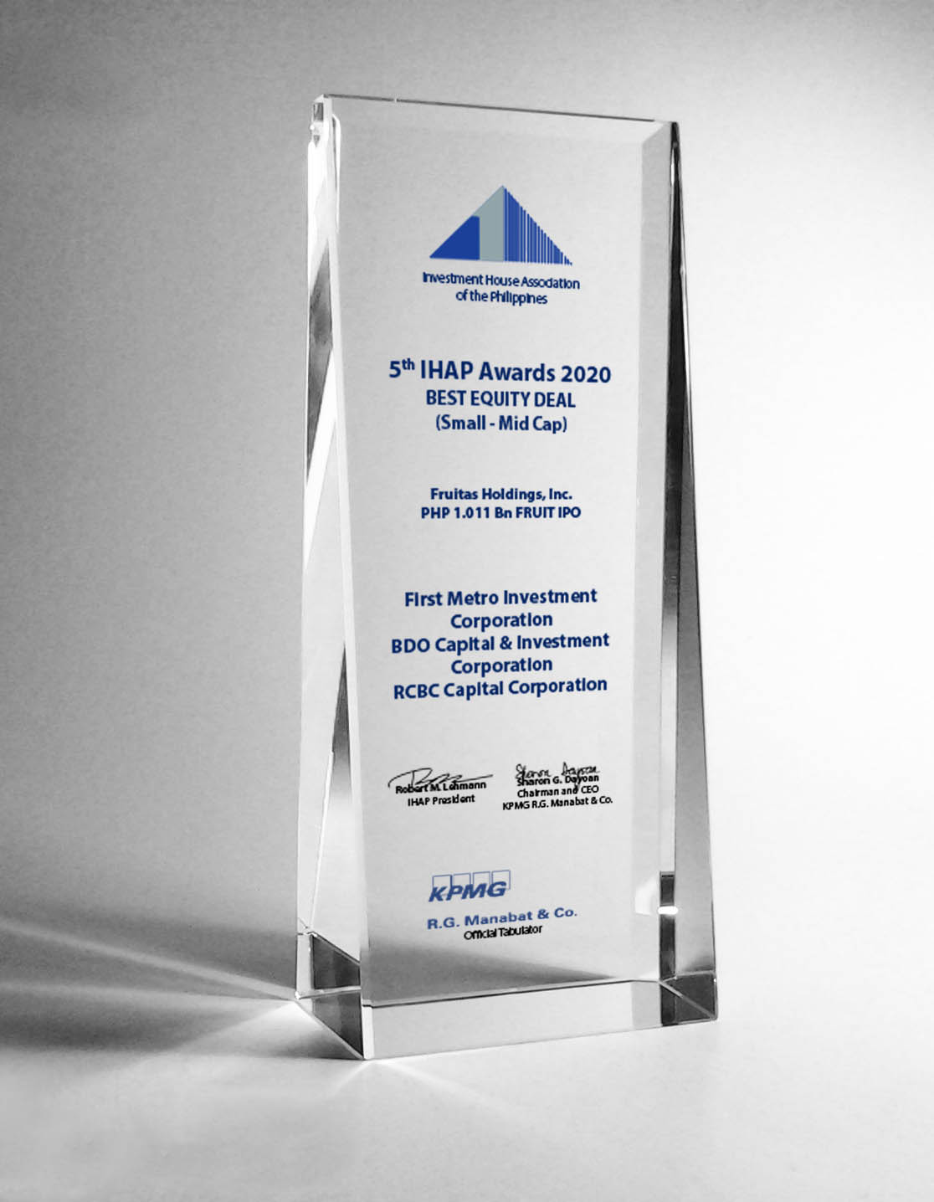
BEST EQUITY DEAL Small – Mid Cap
Notes:
VIO CHUA
The Best Equity Deal in the Small to Mid Cap category goes to Fruitas Holdings, Inc.’s PHP 1.011 Bn Initial Public Offering of FRUIT in the PSE.
The awardees are:
FIRST METRO INVESTMENT CORPORATION and
BDO CAPITAL & INVESTMEMT CORPORATION
As Joint Issue Managers, Joint Lead Underwriters, Joint Bookrunners, and
RCBC CAPITAL CORPORATION
As Participating Underwriter

Slide 17
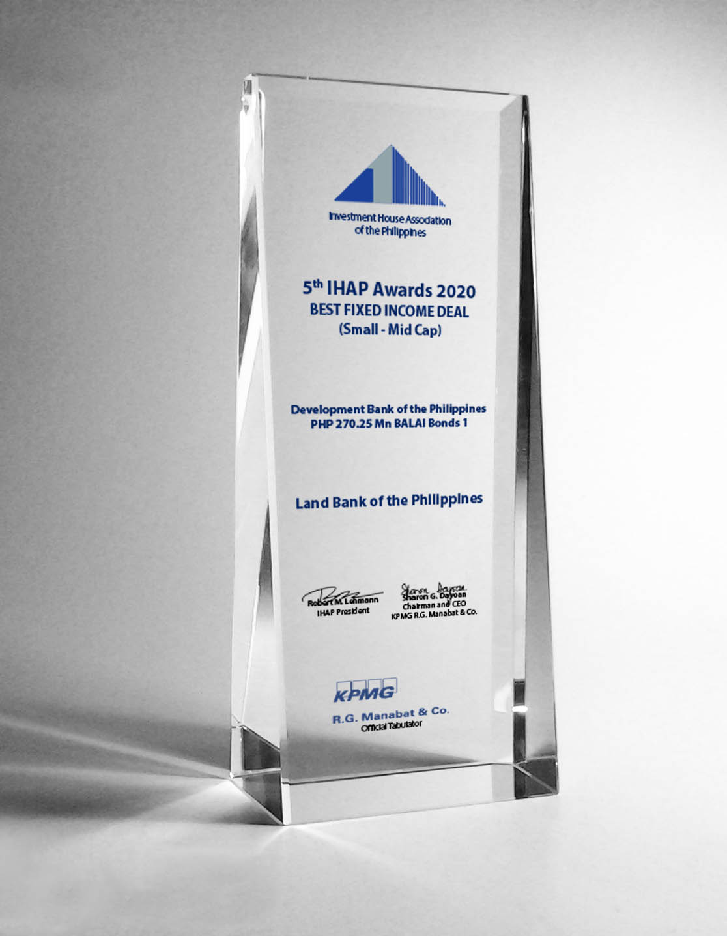
BEST FIXED INCOME DEAL Small – Mid Cap

Slide 18
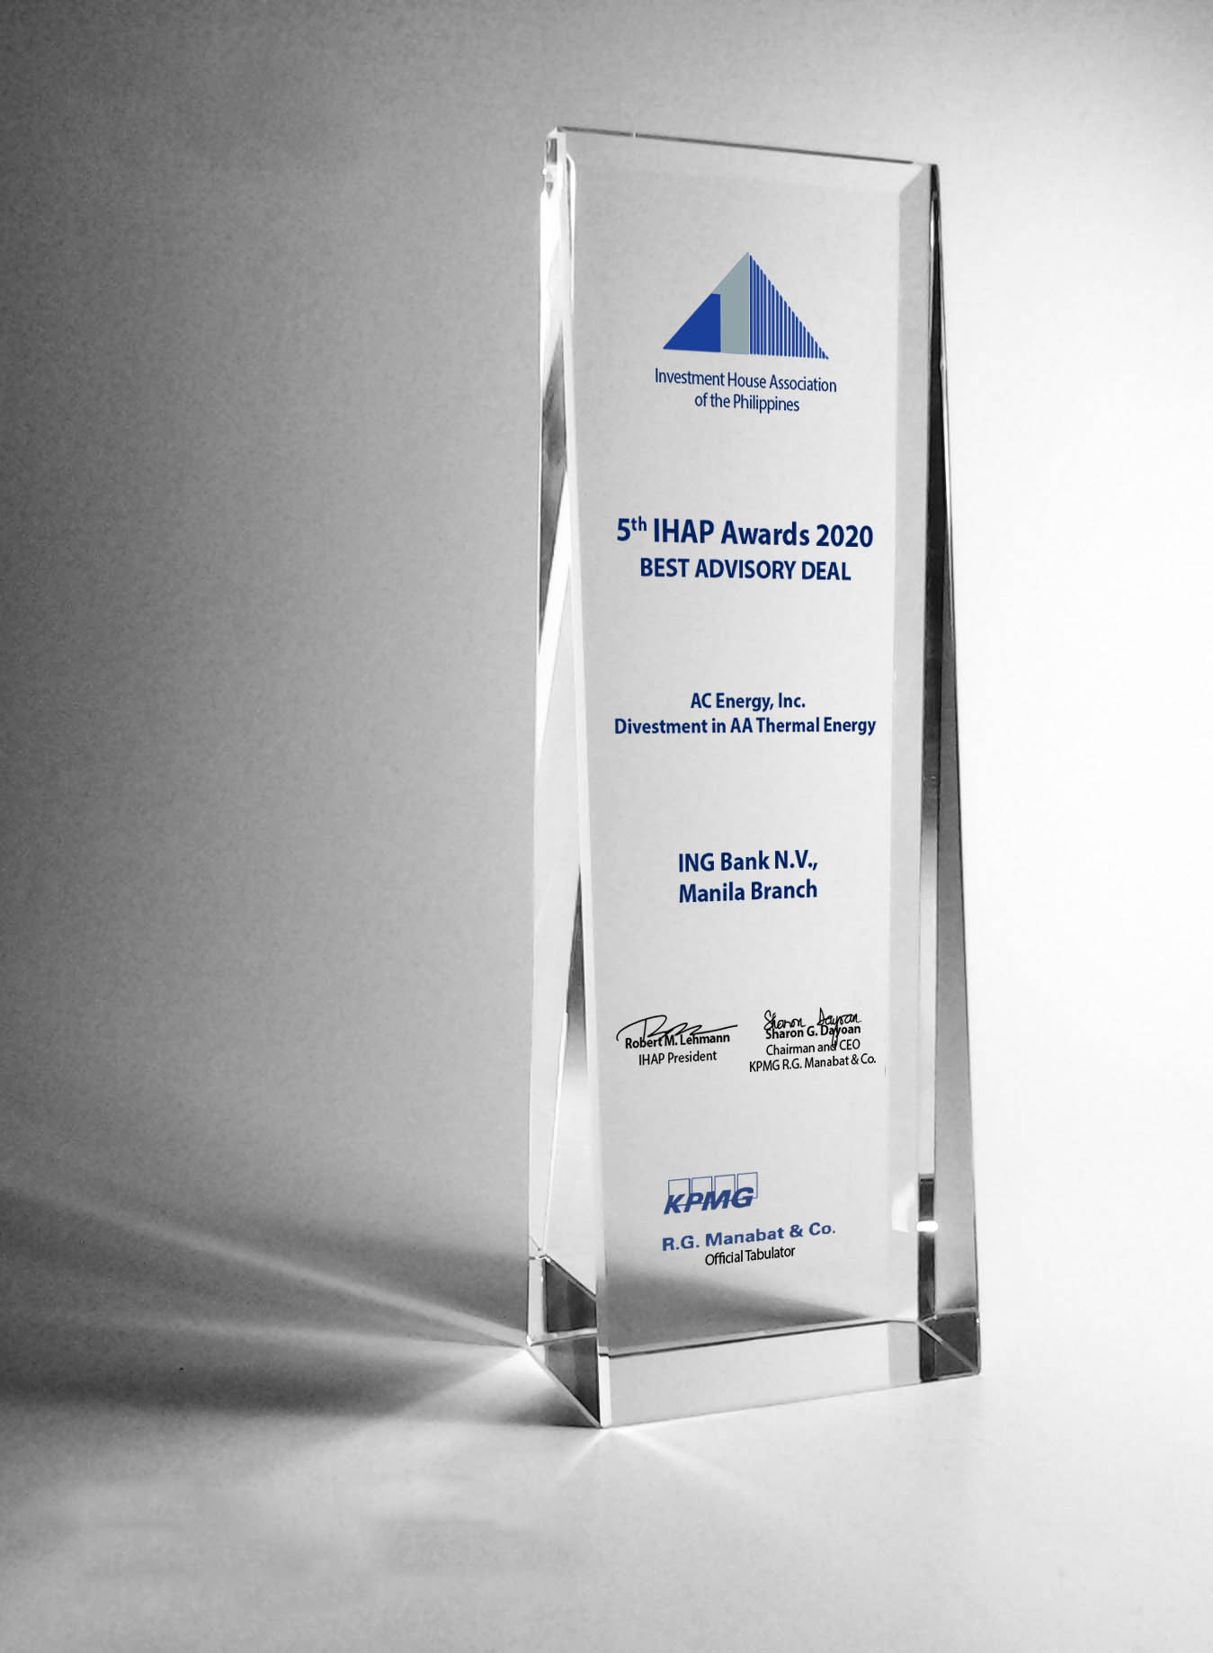
BEST ADVISORY DEAL

Slide 19
BEST ADVISORY HOUSE TIE

Slide 20
BEST EQUITY DEAL

Slide 21
BEST EQUITY HOUSE
Notes:
HANS SICAT
For the Best Equity House of the Year, the winner is BDO CAPITAL & INVESTMENT CORPORATION. Congratulations!

Slide 22
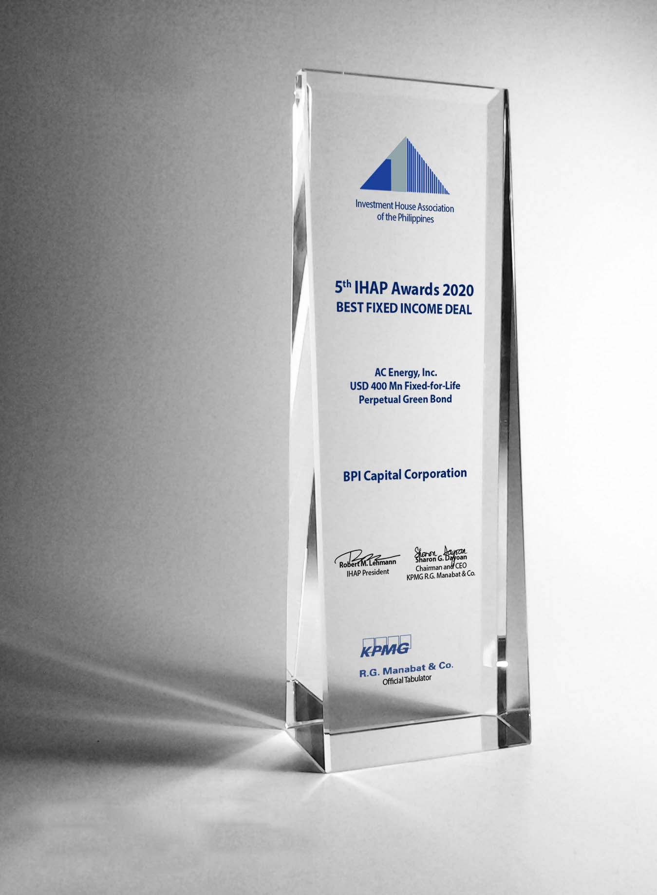
BEST FIXED INCOME DEAL TIE

Slide 23
BEST FIXED INCOME HOUSE TIE

Slide 24
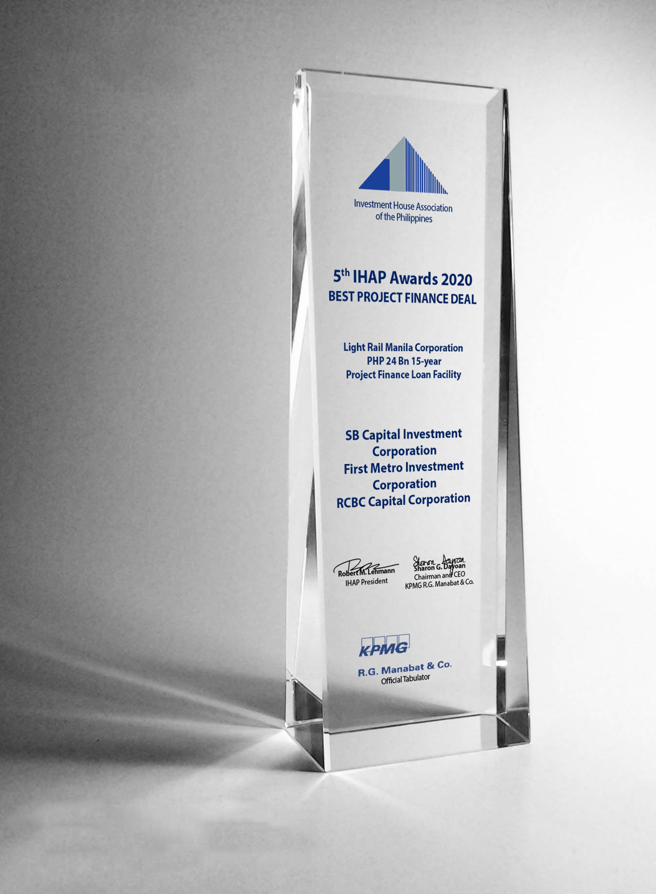
BEST PROJECT FINANCE DEAL TIE

Slide 25
BEST PROJECT FINANCE HOUSE
Notes:
NOEL DAYRIT
The award for the Best Project Finance House of the Year goes to BDO CAPITAL & INVESTMENT CORPORATION. Congratulations!

Slide 26
DEAL OF THE YEAR

Slide 27
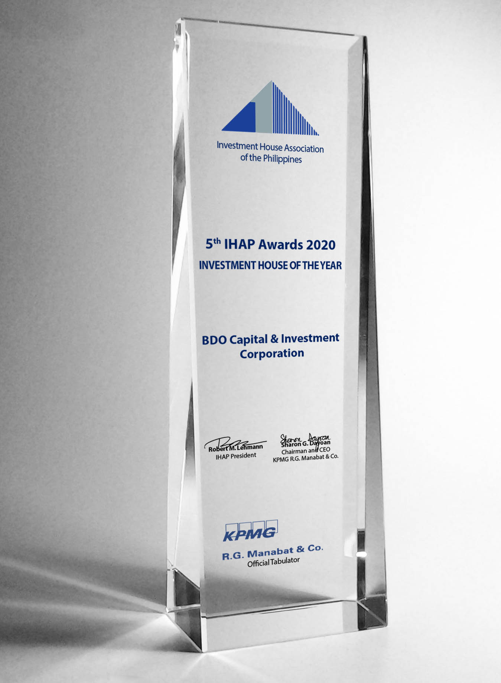
INVESTMENT HOUSE OF THE YEAR

